Slide 1
Play Local
The St Luke’s Hospice Lottery
Town Funder Presentation
March 2014

Slide 2
About me
Leia Bunker – Lottery & Regular Giving Development Manager for St Luke’s Hospice in Sheffield
Focus on individual giving through Lottery, regular donations and cash appeals
Significant portion of the role is marketing and promotion
Focus is low value, high volume plus ‘feeding the funnel’ for potential major donors

Slide 3
About St Luke’s
Sheffield’s only adult hospice
Control symptoms, alleviate pain, and offer the best possible quality of life – all free of charge
Every year we help 1,400 patients, their families and carers – more than 5,000 people in all
Not just for cancer patients
Most of our patients never set foot in the hospice itself
Notes:
We care for people of all ages 18 and upwards throughout Sheffield who have incurable illnesses
Life limiting illnesses include neurological conditions, HIV and end-stage heart, kidney and lung conditions
Our St Luke’s community nurses (not Macmillan) care for them in their own homes.

Slide 4
Our finances
St Luke’s is an independent charity, not part of the NHS:
  £7.5m a year to run all our services
  NHS funding covers a declining proportion of our operating costs – currently 31%
  Majority of our income from the Sheffield public through our fundraising activity: over £4.5m a year
  Over £1.6m through our 11 charity shops
  Over £600,000 raised through our Lottery
Notes:
Target of over £800,000 through Lottery for 2014/15

Slide 5
About the Lottery – early days
Established in October 1994
1,313 entries in the first draw – all recruited via door-to-door canvassing by our first two Cash Collectors
Peak membership in 1999 with over 15,000 members across Sheffield and beyond
Over £9m raised for St Luke’s through Lottery to date

Slide 6
About the Lottery - present day
Over 12,000 regular entries (10,500 members)
2,500 still playing by regular cash collection
Over 4,500 members now playing by regular Direct Debit at £4.34 per month
Plus 150 single tickets sold each week
Notes:
Remainder pay by SO and cheque
Aspiration to grow membership to 20,000 regular members by March 2016
Highly recommend Direct Debits over Standing Orders – more visibility and control

Slide 7
Prize structure
Rollover prize starting at £350, reaching a maximum of £10,000
Weekly first prize £2,000
Weekly second prize £150
Plus 100 x £5 prizes
All winners are notified automatically
Draw results published on our website each week

Slide 8
Regulation
Licensed by the Gambling Commission
Hold both Remote and Non-Remote Licenses
Member of the Hospice Lotteries Association and Responsible Gambling Trust
Gamble Aware information printed on all literature in line with Social Responsibility in Gambling Policy
Notes:
If more than £20,000 worth of tickets put on sale for a single lottery or aggregate proceeds from all lotteries in one year exceed £250,000 then need to register with Gambling Commission. If less than can register with local authority.
Worth working this out as fees for Local Authority start from £40 but Gambling Commission fees can reach over £1,500 per annum!

Slide 9
Marketing and promotion
25% growth in last 12 months
70% new entries in 2013 achieved through door-to-door canvassing
Remainder through:
  Venue canvassing (supermarkets, shopping centres)
  Online (web, social media, PPC)
  Leaflets (hospice reception, 12 charity shops, OPUS)
  Upgrade / conversion campaigns
  Rebrand launch
Notes:
Trying new methods all the time – very much dependent on charity and area. Other hospices have had successes with advertising in newspapers – when St Luke’s tried it we only got 1 sign up for £600! Also tried telephone fundraising with mixed success. Highly recommend online channels to attract new audiences, particularly with low cost per acquisition.

Slide 10
Market research
Key findings in 2012 showed:
  Primary motivation is the odds of winning
  Second is the value of the prize money
  Third is the good causes/charities supported
31% of the Sheffield population play another Lottery
St Luke’s has the highest spontaneous awareness of all local charities
However, 4 in 5 of those aware of St Luke’s do not currently support the hospice
Notes:
In November 2012, St Luke’s commissioned Action Point to undertake independent market research into motivations for support amongst Sheffield residents
Massive opportunity to recruit new members – hence introducing door to door canvassing – average penetration for local hospice lotteries is approx 5%. When I started we were only at 1.5% and even now stands at 2.4%

Slide 11
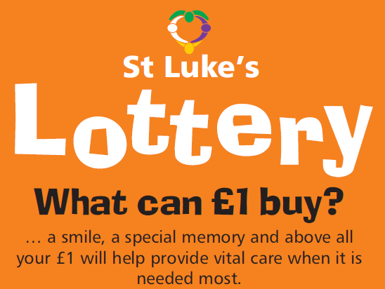
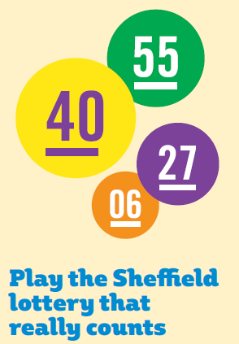
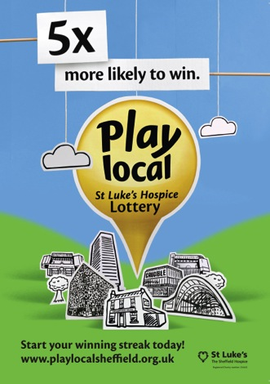
The brand journey so far
2008
2011
2013
Notes:
Slowly moved from patient focus to winning messages, but kept local element to make it personal

Slide 12
Key messages
Five times more likely to win
  1 in 11,000 vs 1 in 55,000 chance to win a four-figure sum
Cheaper tickets, better odds of winning
  £1 = £2,000 with Play Local
  £2 = £1,000 with National Lotto (matching five balls)
If you play local, your money stays local
  Over 53p in every £1 goes direct to patient care
  Your Sheffield Hospice
Notes:
Rebrand launch in October – at the same time the National Lottery made changes to the Lotto game by increasing tickets to £2 each and changing prize structure. Capitalised on the opportunity to make direct comparisons

Slide 13
Member benefits
Every £1 supports St Luke’s patients and their families
Twice yearly Lottery Player newsletter featuring winners’ stories and latest updates
Annual Lottery Winners’ Tea Party
Twice yearly Grand Draws with additional prizes
Annual ‘Anniversary Draws’ introduced from April 2014
Bespoke Lottery website www.playlocalsheffield.org.uk
Notes:
Top tip – send thank you letters in January – usually highest month for cancellations!
M&S vouchers are great incentives for older players - add credibility

Slide 14
20th Anniversary
Play Local is 20 years old this October!
Special ‘Birthday Party’ for longest playing members
20th Anniversary Grand Draw
20 day online countdown, including competitions
Special rewards for ‘refer a friend’
Notes:
Combining Lottery draw with Grand Draw needs advance notification to members, but means doubling prize fund is much easier and saves money overall, plus regular members get ‘free’ entry

Slide 15
Challenges and pitfalls
ELM or in-house?
Cost of promotion (including 80/20 rule)
Attrition
Third party fundraising
Remote vs Non-Remote entries
Reputation / complaints
Notes:
Whilst they may seem expensive, for St Luke’s ELM’s are the right choice – need to have the staff structure in place to support otherwise
Do not under-estimate the costs of promoting the lottery! If you get a cost/income ratio above 50/50 you’re doing well!
Average attrition differs depending on recruitment method and method of payment, e.g. St Luke’s plans for 8% attrition from long-term members vs. 20% from new sign ups. Also another good reason to have a decent ELM!
Third parties cannot fundraise for you via lotteries, raffles etc. unless they either have a license, or all data is processed by you and included on Gambling Commission returns – there are some ‘get out clauses’…

Slide 16
When is a Lottery not a Lottery?
Free prize draws
Skill competitions
One-off event raffles
Private lotteries
Notes:
Free must be free – can have ‘suggested donation’ but not ‘minimum donation’. However, data doesn’t count and providing the data protection statement is clear enough, no reason you can’t upgrade later!
Skill – must ensure sufficient skill to exclude a significant proportion from entering and/or winning a prize. Single question not sufficient, nor allowed to provide the answer best examples are crossword puzzles/pub quizzes – multiple questions and winner drawn from correct entries
One-off event raffles means all tickets sold on premises and winner drawn during event. Also can’t be held at commercial events. Strict budgets in place – max. £500 for prizes and £100 for costs. If tickets are to be sold in advance then would not count.
Private lotteries e.g. within workplace, resident’s association etc. not regulated, however only accounts for prizes and ‘reasonable expenses’ if portion of proceeds are going to charity then counts as Society Lottery. Also watch out – must work on same premises etc, no ‘partners’ or customers or will count as Lottery

Slide 17
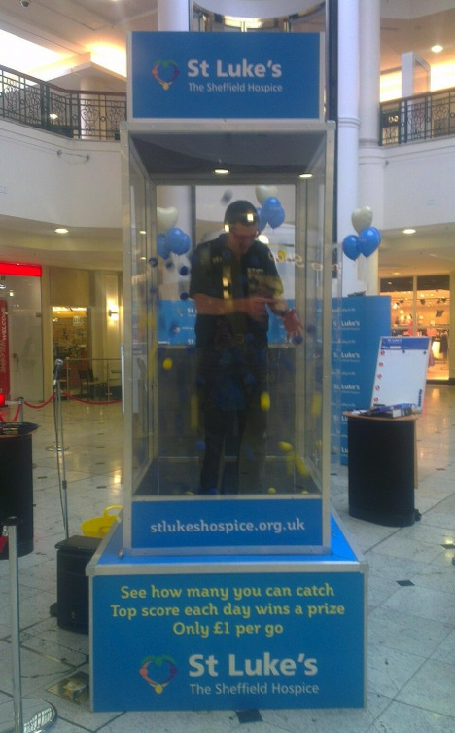
The game cube
Great for ‘local’ fundraising
Events and partnerships
Counts as a ‘skill competition’!
No age limits
Returns are what you make of it
Notes:
St Luke’s using this year as part of Charity of the Year partnership with Meadowhall Shopping Centre
However there is height restriction and admin requirements for H&S
Happy Volunteers essential!

Slide 18
Any Questions?
Thank you.

