Slide 1
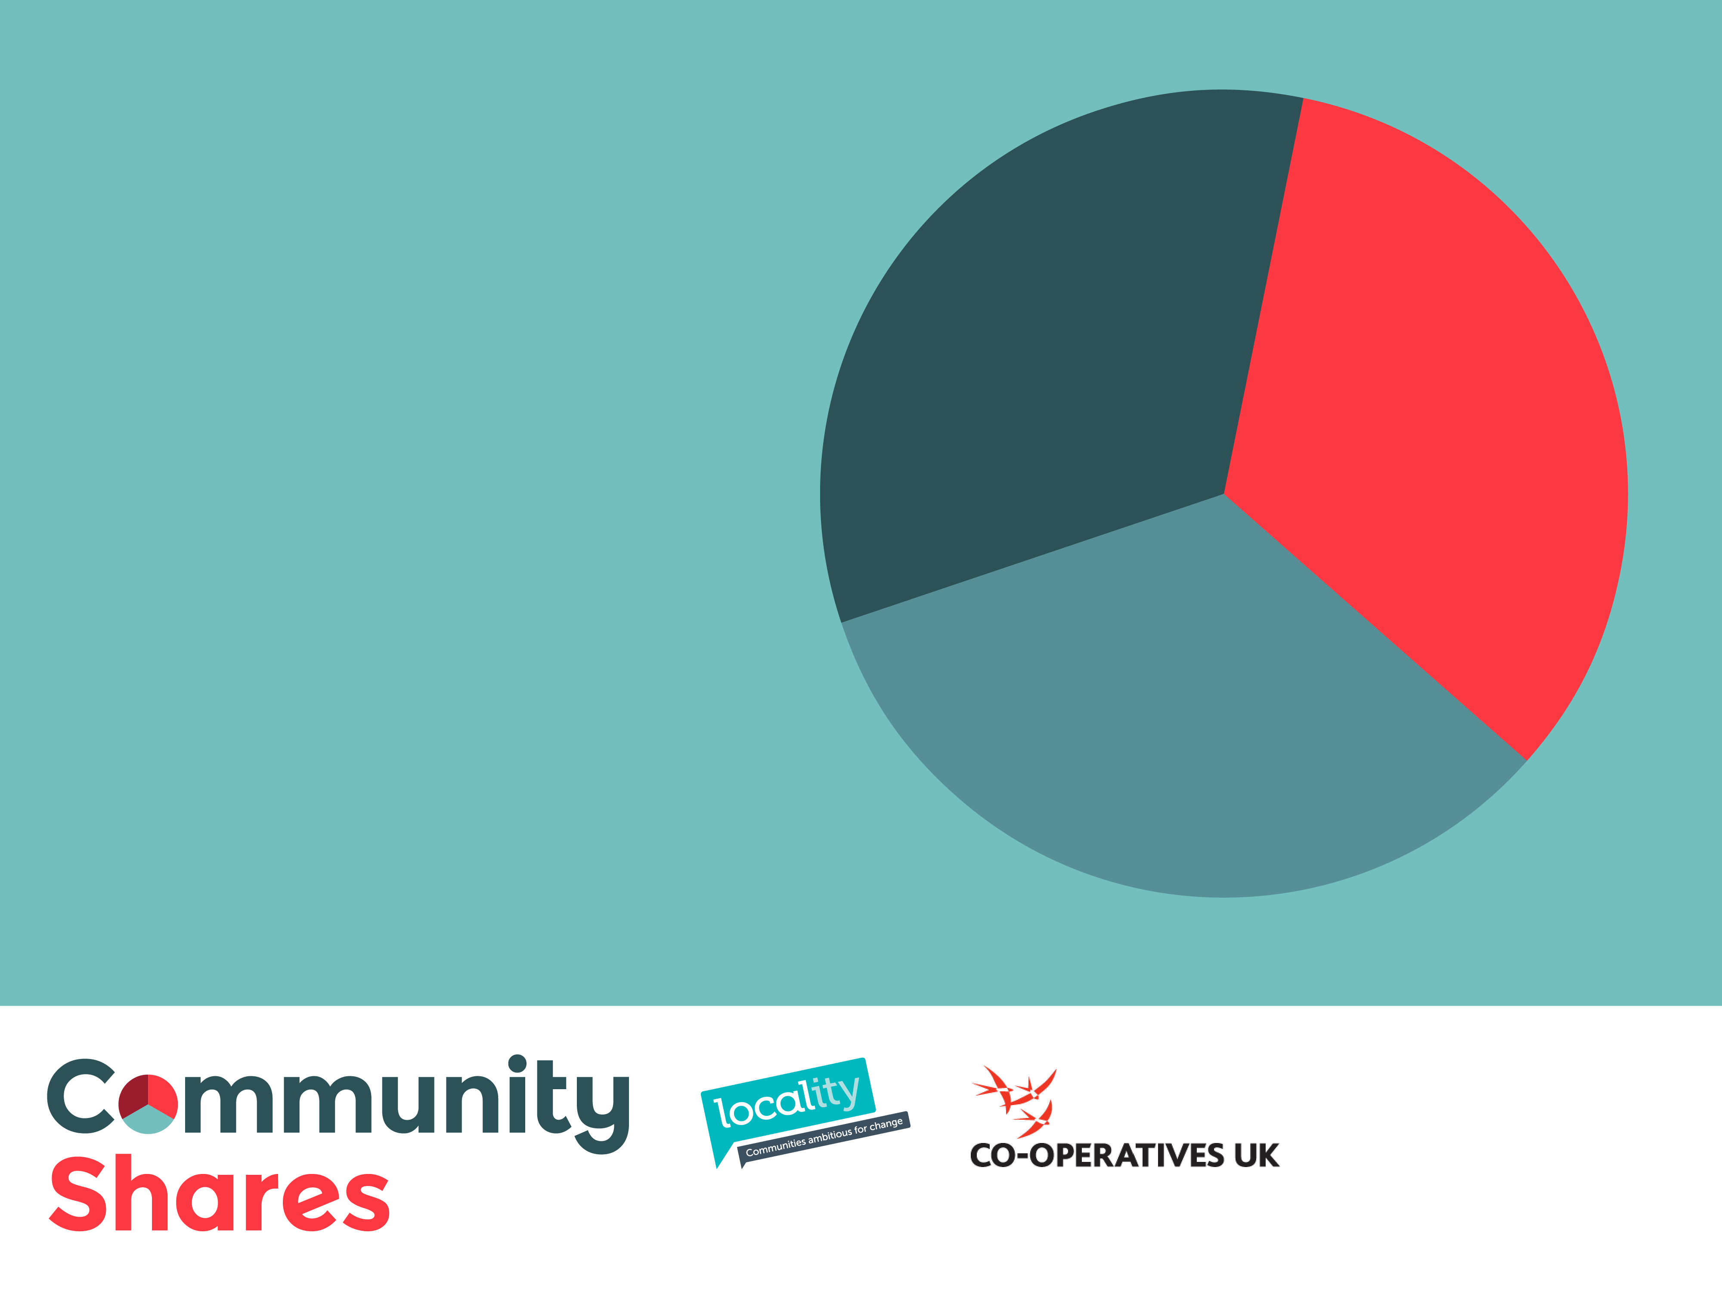
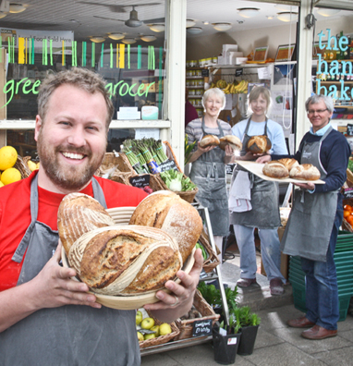

Introducing Community Shares

Slide 2
What is the Community Shares Unit?
DCLG-funded programme launched in 2012 and running to March 2015
Partnership between Co-operatives UK and Locality
Objective to grow the market for community shares, supporting:
Supporters exploring the community shares market
Intermediaries, practitioners and advisers involved in comshares
Communities looking to develop share offers

Slide 3
The benefits of community shares
Capital
“Community shares offers can provide long-term risk capital linked to the performance of the society”
Leverage
“Community share offers can lever further funding based on the ‘first move’ of the community”
Governance
“Community shares can give members meaningful involvement in the running of the society”
Operation
Community share offers can ‘bake in’ the customer base and promote member involvement in the operation of the enterprise”

Slide 4
Community shares market indicators: 2009 - 2014
Nearly 500 new societies registered
Almost 200 share offers undertaken
Est. £35m raised from over 35,000 members
Average offer raised £175,000
Average membership
175 members
Average investment per member £750

Slide 5
Key pillars of a successful share offer
Business model
Community engagement
Governance
Offer document
Profitable
Viable
Sustainable
Scale and scope
Attracting support
Legal form
Rules
Building membership
Conduct
Accurate
Share offer ‘campaign’
Informative

Slide 6
Types of share offer
Pioneer Offer
Open Offer
New societies seeking high-risk capital from committed members to get investment ready
Time-bound offer
Typical share offer for start-up or growth underpinned by investment target for a set period. Members refunded if target not achieved
Membership Offer
Traditional arrangement for co-operatives to offer membership at a nominal sum to attract and retain members
Targeted at established societies that have been trading for a significant period and want to encourage new and existing members to invest to support growth or extend liquidity

Slide 7

Case Study: Bell Inn, Bath
An iconic pub in central Bath suddenly came up for sale as the owners were retiring
A strong community of regulars, musicians and local residents were determined to preserve the ethos of the pub – they had 12 weeks to organise a community buyout
In this short period, the community raised £750,000 and secured mainstream debt finance to meet the overall purchase price of nearly £1m
The Bell Inn is a viable business which will enable interest payments to shareholders, alongside facility for withdrawals

Slide 8
With growth comes ‘responsibility’ - the work of the CSU
CSU is working to develop the tools and structures that will support greater responsibility over quality for community share offers
Market intelligence
Community Shares Handbook
Practitioner training and accreditation
Advice and Support
CSU compliance mark / Microgenius
Best practice share offers

Slide 9
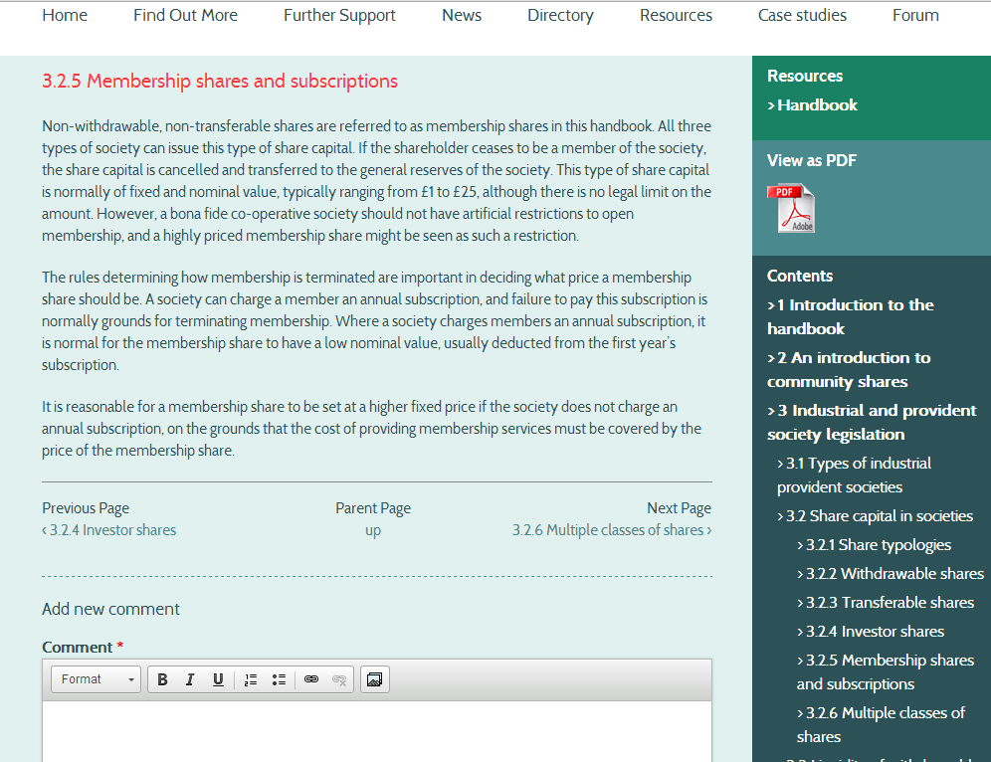
Community Shares Handbook
Consolidation of all advice materials to form Community Shares Handbook
Collaboratively developed with practitioners through an online platform
Regularly updated and monitored to ensure relevancy and accuracy
Oversight from a technical committee of government representatives and FCA

Slide 10
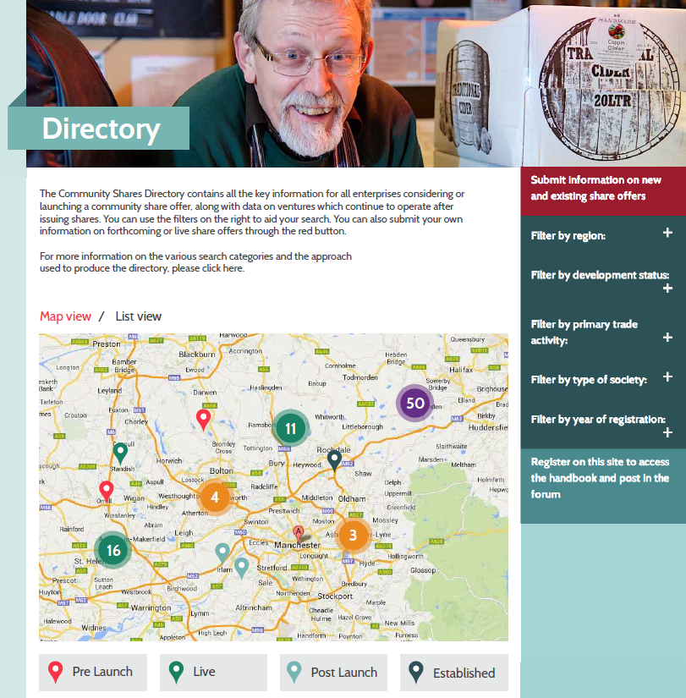
Market Intelligence
Regularly updated directory of registrations, share offers and annual returns
Searchable and exportable data
Forms the basis for more in-depth research into the development of community shares market

Slide 11
Market Intelligence
Partnership with Manchester Business School to develop a sophisticated database of community share intelligence that will cover:
An in-depth review of the share offer document library to capture analytics on financials, community benefit and leverage
An insight into investor behaviour using Microgenius as a key source of information, both analysing the raw data generated by the platform as well as undertaking an in-depth survey of Microgenius users
Analysis of annual returns of share offer societies trading for a number of years to understand how liquidity is working in practice, alongside membership churn and returns to investors

Slide 12
Community Shares Handbook
1. An introduction to community shares
2. Industrial and provident society legislation
3. Governing documents
4. Offer documents
5. Promoting offers
6. Use and distribution of profit
7. Guidance and regulation
8. Tax treatment

Slide 13
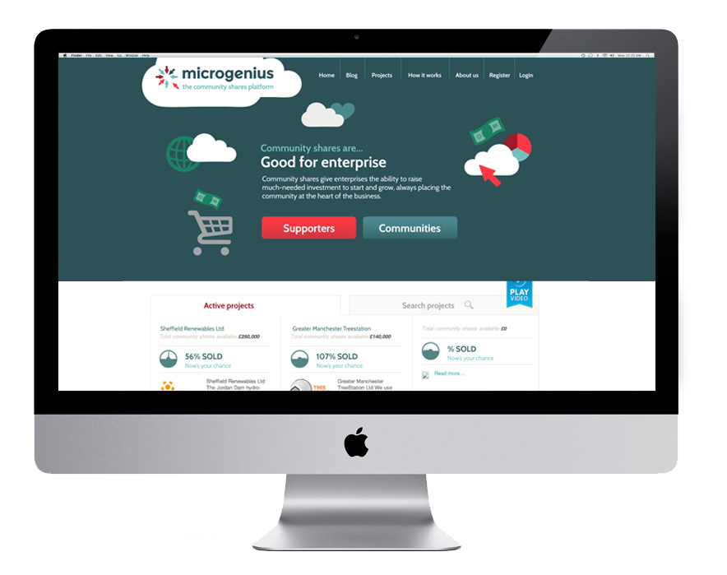
Introducing Microgenius
Technological tool for both enterprises and supporters
Secure payment facility
Shareholder register
Social media and online presence
Visible portal for all compliant share offers

Slide 14
Community Shares Quiz
Microgenius data – eight share offers hosted as part of the pilot raising over £1m
Q1. What is the average investment on Microgenius?
a) £175
b) £450
c) £800
Q2. What percentage of investors purchase the minimum amount of shares?
a) 40%
b) 50%
c) 60%
Q3. What percentage of Hastings investors fall in the Hastings TN post-code?
a) 38%
b) 54%
c) 67%

Slide 15
CSU and market development
By sector:
exploring the use of community shares in new and emerging markets such as heritage, housing, media and transport
By geography: developing a ‘hub and spoke’ model for a UK-wide CSU which works alongside the devolved nations
By audience:
engaging new and promising audiences such as local authorities, CDFIs and charities

Slide 16
Get in touch
www.communityshares.org.uk
www.microgenius.org.uk
communityshares@uk.coop

