Slide 1
Mansfield Town’s Crowdfunding Experience
‘Make Mansfield Your Hotspot’
Sarah Nelson – Mansfield BID Manager

Slide 2

The Mansfield BID
April 2010
55% in favour
65% aggregate rateable value
Average Levy £290,000 per year
Additional revenue generated from other areas i.e.. radio scheme
13 Board Members
Marketing, Safe & Secure, Cleansing & Maintenance, Access, Investing, Appealing

Slide 3
Why Crowdfunding ?
Unsuccessful with Portas Application
Introduced by ATCM
Spacehive Introduced – easy process
Unique concept to raise funds
Engage community / stakeholders
Grab media attention
Support provided

Slide 4
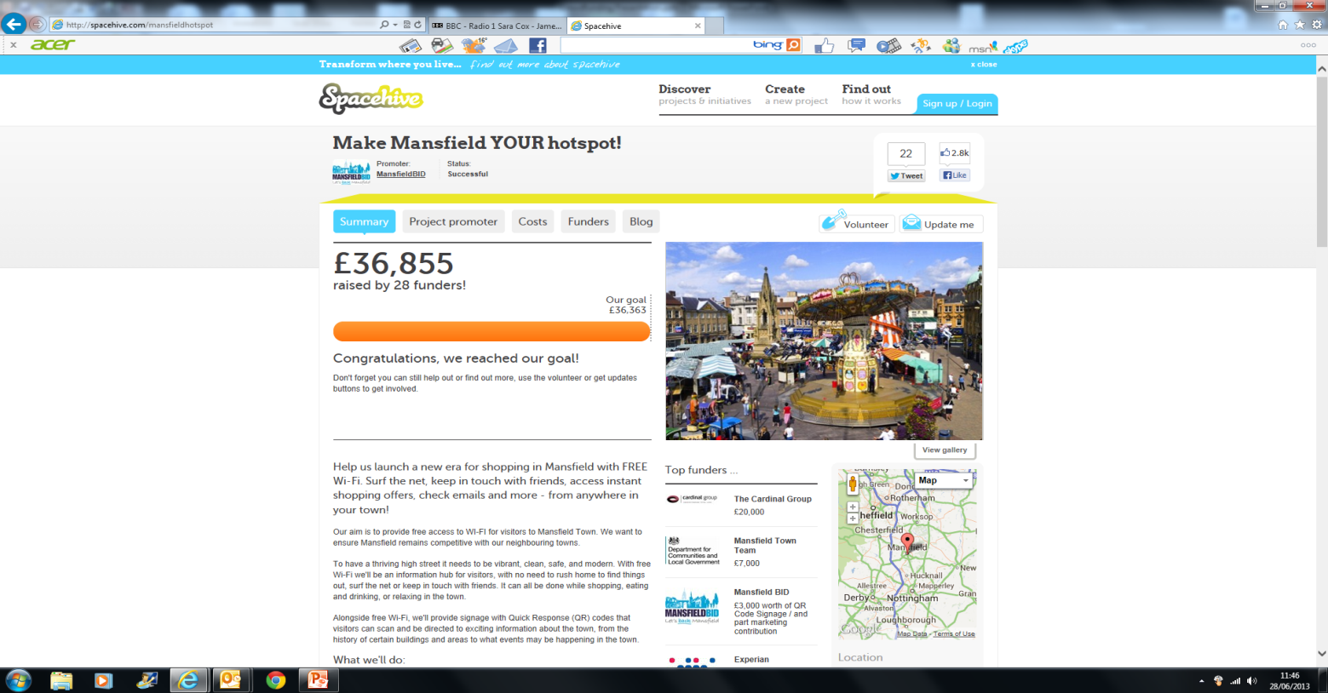
Process
Clear steps via Spacehive
Costs set
Timescale decided
Project uploaded
Verification
Target audiences set
Marketing Package designed
Launch

Slide 5
Key element – MARKETING
Be aware of audience
Get the message right / ‘by in’ –
  Make Mansfield Your Hotspot
Launch event
Flood Media – Press releases, radio Interviews, TV
Information to potential Stakeholders
- Letters / Information packs
- Networking
- Presentations
- SOCIAL MEDIA
Continuous updates
    Celebrate Milestones
    Reminder of project / importance

Slide 6
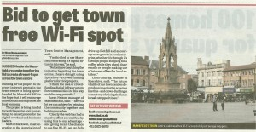
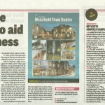

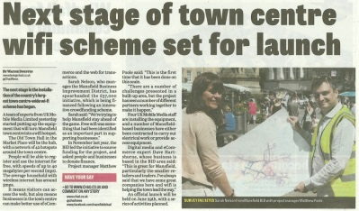
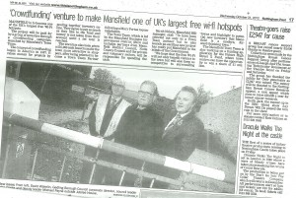
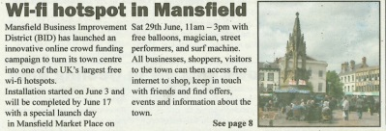
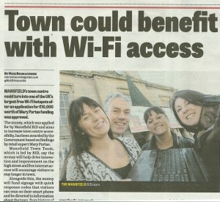
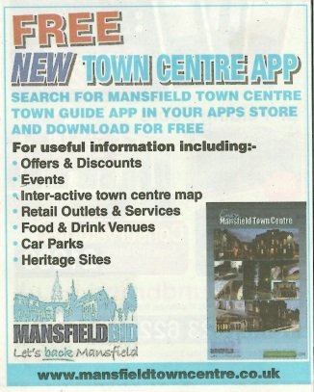
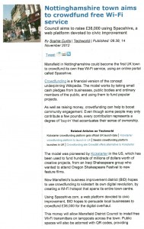
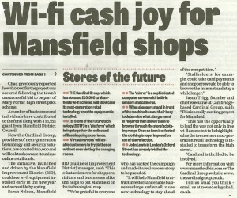
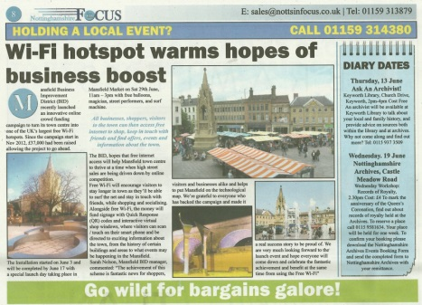
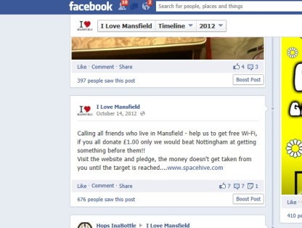
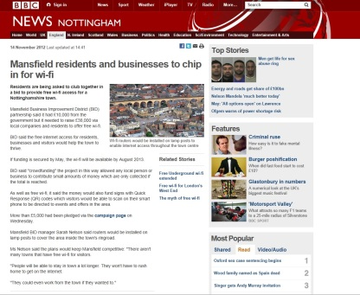
Press Examples

Slide 7
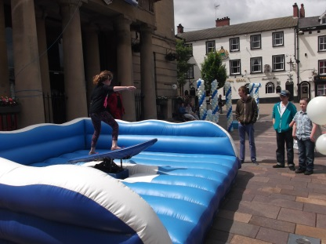
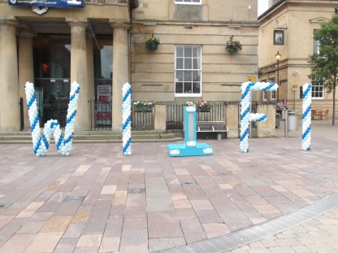
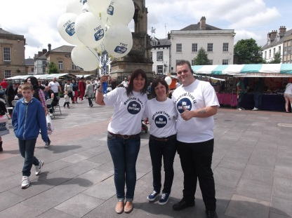
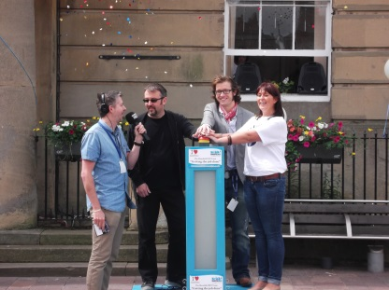
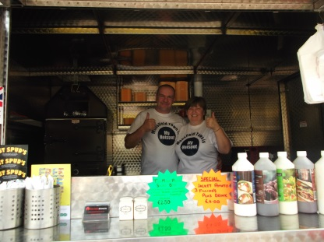
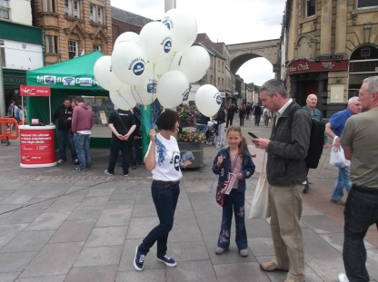
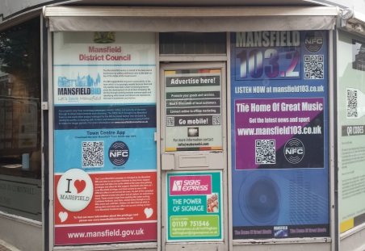
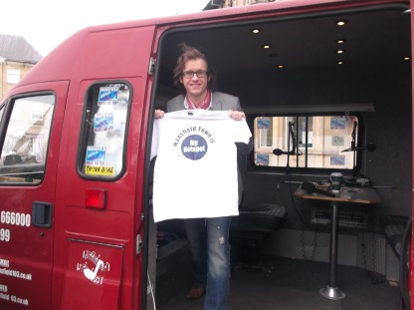
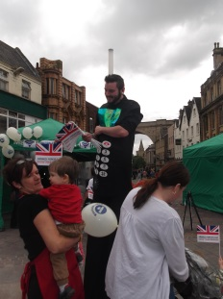
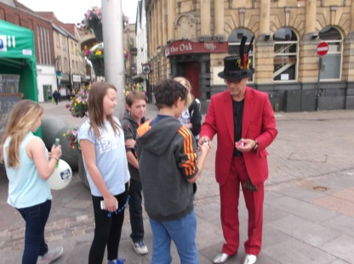
Outcome
Funds Raised
Press Release
Procurement Process
Wi Fi Installation
Switch on Event
Feedback

Slide 8
TIPS
Careful consideration for project
Realistic Timescale
Know the audience
Detailed Marketing Plan
- Create a buzz
-Generate community engagement
Continual updates
Celebrate

Slide 9
MANY THANKS
FOR LISTENING
01623 635675
Sarah@mansfieldbid.com
Notes:
So thanks for listening – I will pass to dave now and then we can take questions at the end

