Slide 1
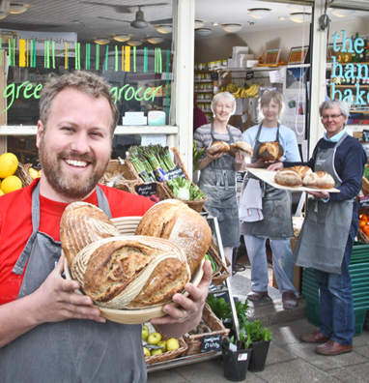
Introducing Community Shares

Slide 2
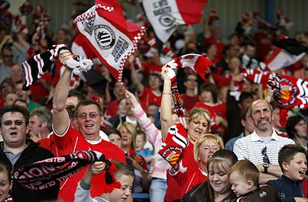
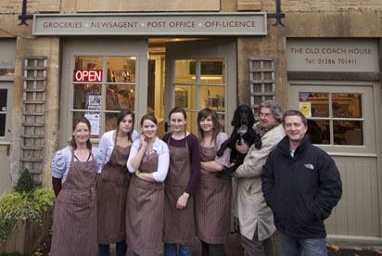
Community shares in pictures

Slide 3
The Importance of Equity: The Limitations of Debt
Debt
Equity
Equity is patient and engaged
Flexible
Risk sharing
Seeks security
Controlling and disengaged
Debt is mechanistic

Slide 4
What are community shares?
“The sale of shares in enterprises serving a community purpose, with the aim of raising at least £10,000 in capital from no fewer than 20 members”
Unique to co-operative and community benefit societies
Non-transferable, nominal
One Member One Vote
Exempt from regulation under the FSMA 2000
Interest payment only sufficient to attract investment
Powered by Withdrawable Share Capital

Slide 5
Community shares market indicators: 2009 - 2014
Nearly 500 new societies registered
Almost 200 share offers undertaken
Est. £35m raised from over 35,000 members
Average offer raised £175,000
Average membership
175 members
Average investment per member £750

Slide 6
Key pillars of a successful share offer
Business model
Community engagement
Governance
Offer document
Profitable
Viable
Sustainable
Scale and scope
Attracting support
Legal form
Rules
Building membership
Conduct
Accurate
Share offer ‘campaign’
Informative

Slide 7
What is the Community Shares Unit?
DCLG-funded programme launched in 2012 and running to March 2015
Partnership between Co-operatives UK and Locality
Objective to grow the market for community shares, supporting:
Supporters exploring the community shares market
Intermediaries, practitioners and advisers involved in comshares
Communities looking to develop share offers

Slide 8
Get in touch
www.communityshares.org.uk
www.microgenius.org.uk
communityshares@uk.coop

